Slide 1
Data Science - Final Project
By Saumin and Olesia

Slide 2
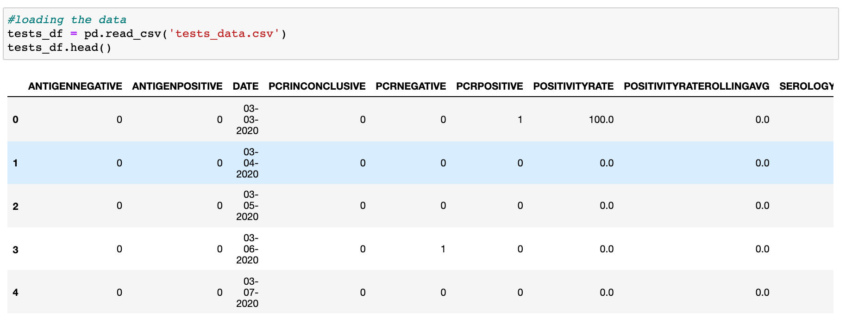
Dataset
For our data analysis we’ve used Saint Louis city databases library and selected Covid-19 test results dataset

Slide 3
Preprocessing Steps
made sure all the features have the correct data types;
broke down the “date” column to create 2 new separate columns “month” and “year” to help us better analyze data;
performed the feature selection with RFE method;
created a box plot to check the outlier and removed the outliers;
we checked the variance and scaled the data using standard scaler method;
before modeling the data, we visualized the data with a scatter plot.

Slide 4
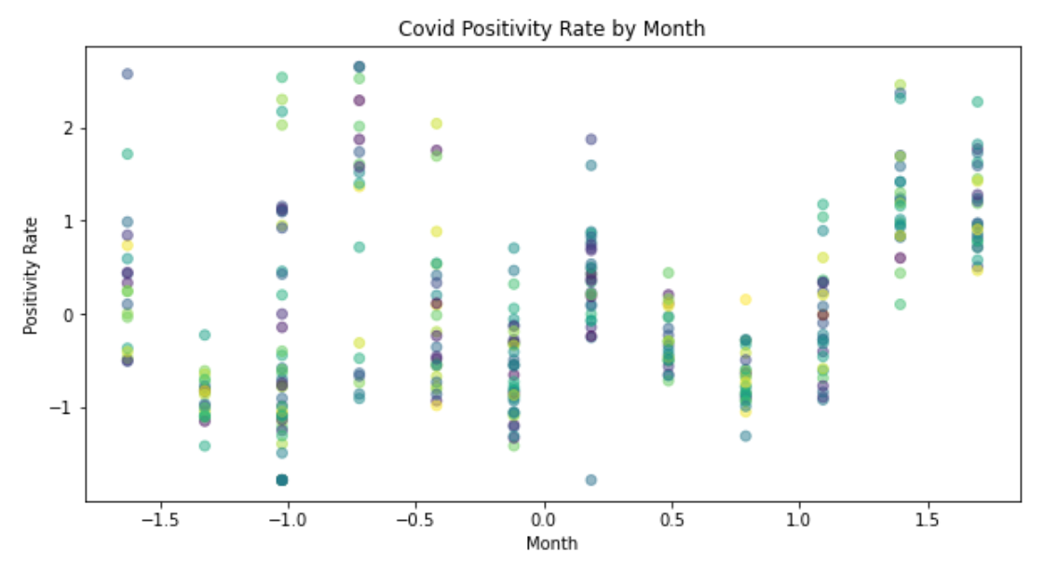
Visualized Data: Scatterplot

Slide 5
Models
We have used 3 total models, 2 of which are supervised and one of them is unsupervised, specifically:
Linear Regression
Random Forest
K-Means

Slide 6
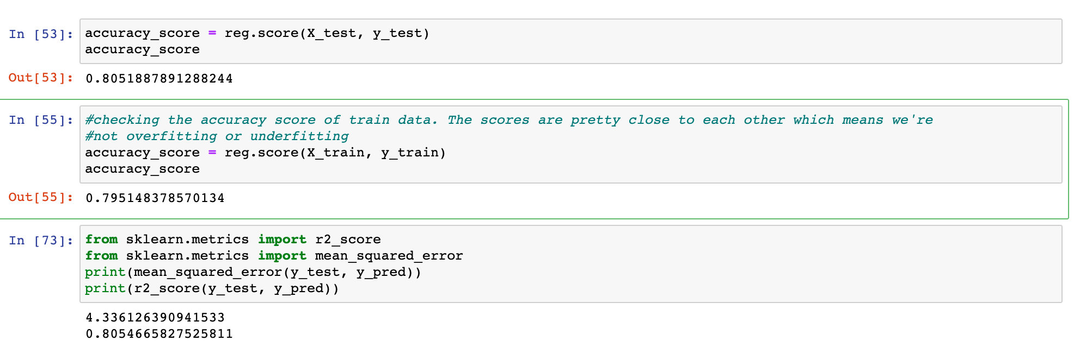
Supervised Machine Learning Models: Linear Regression

Slide 7
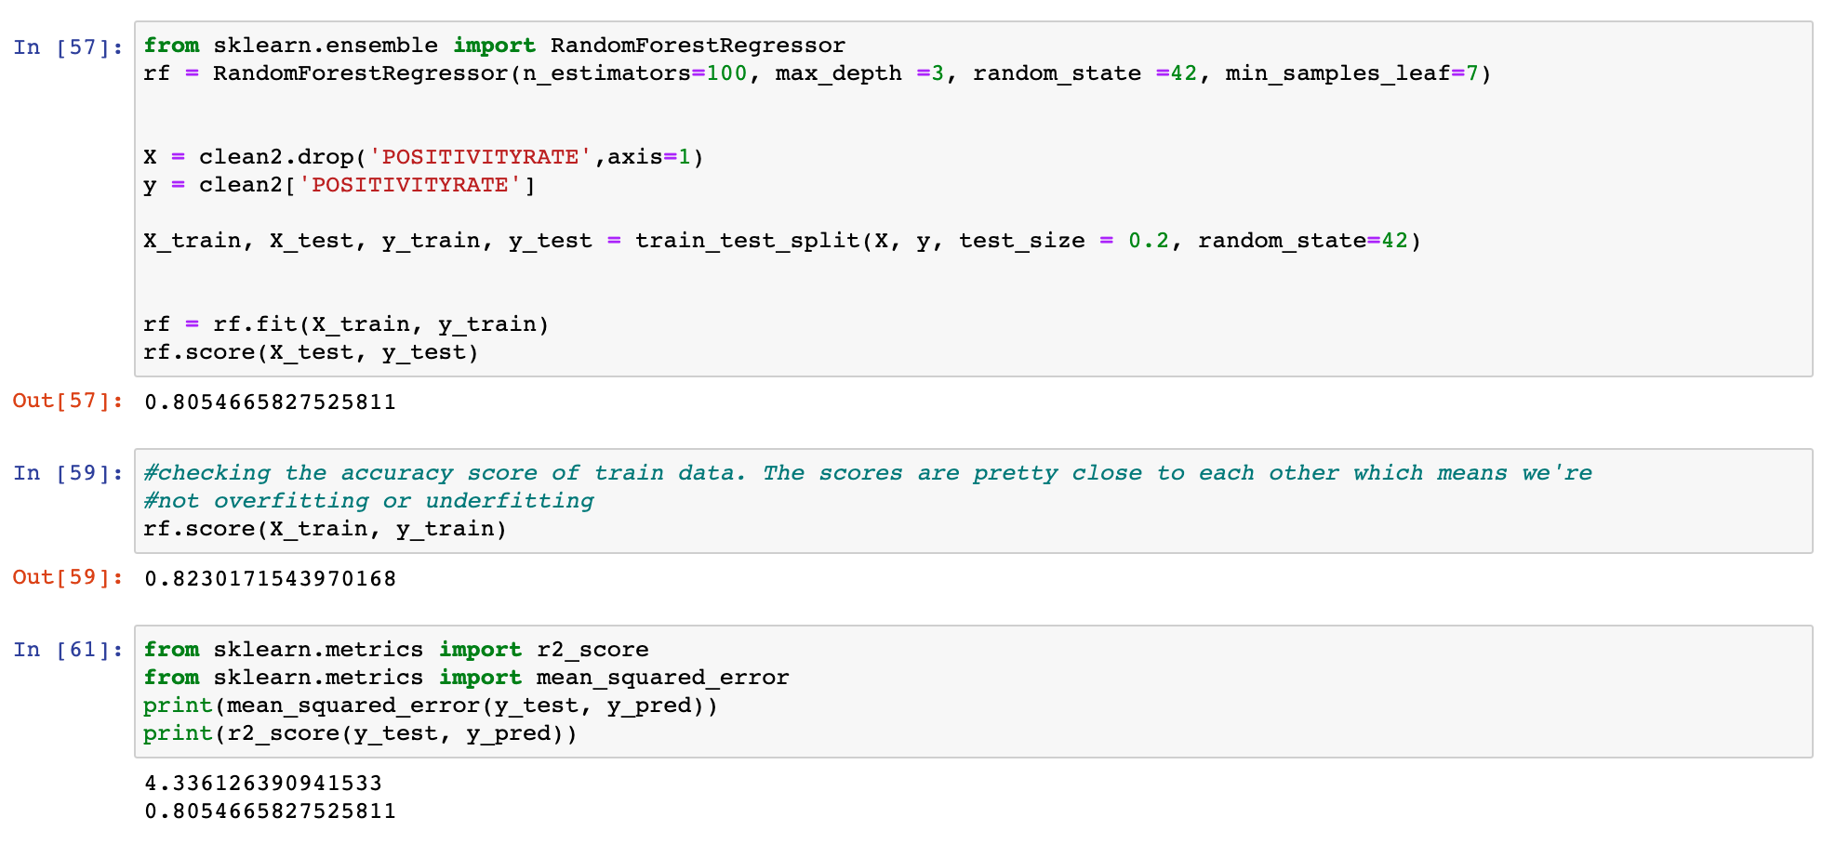
Supervised Machine Learning Models: Random Forest

Slide 8
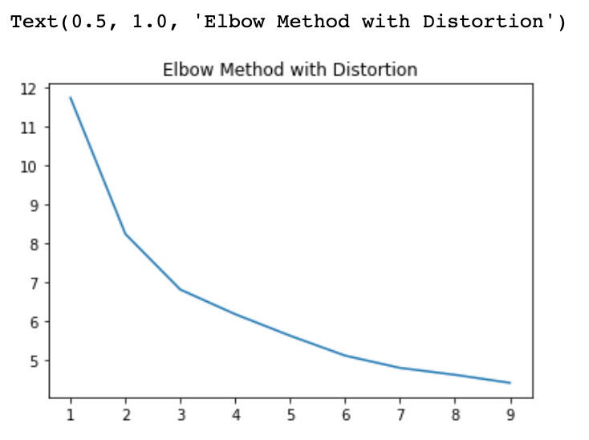
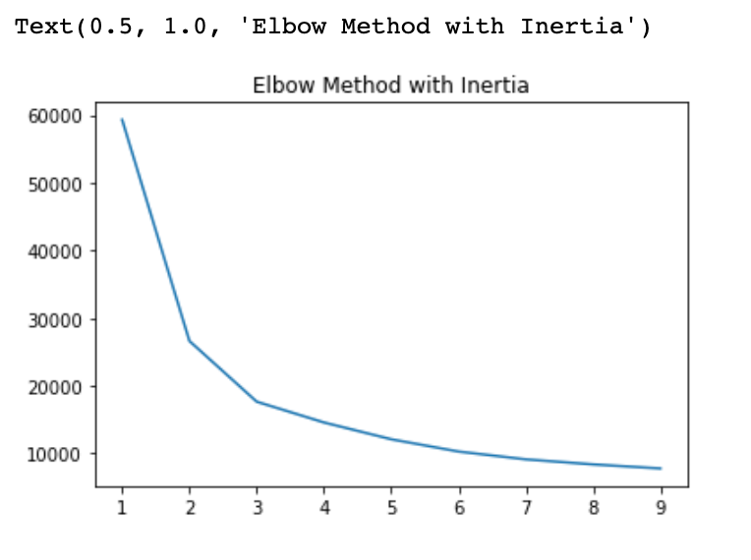
Unsupervised Machine Learning Model: K-Means

Slide 9
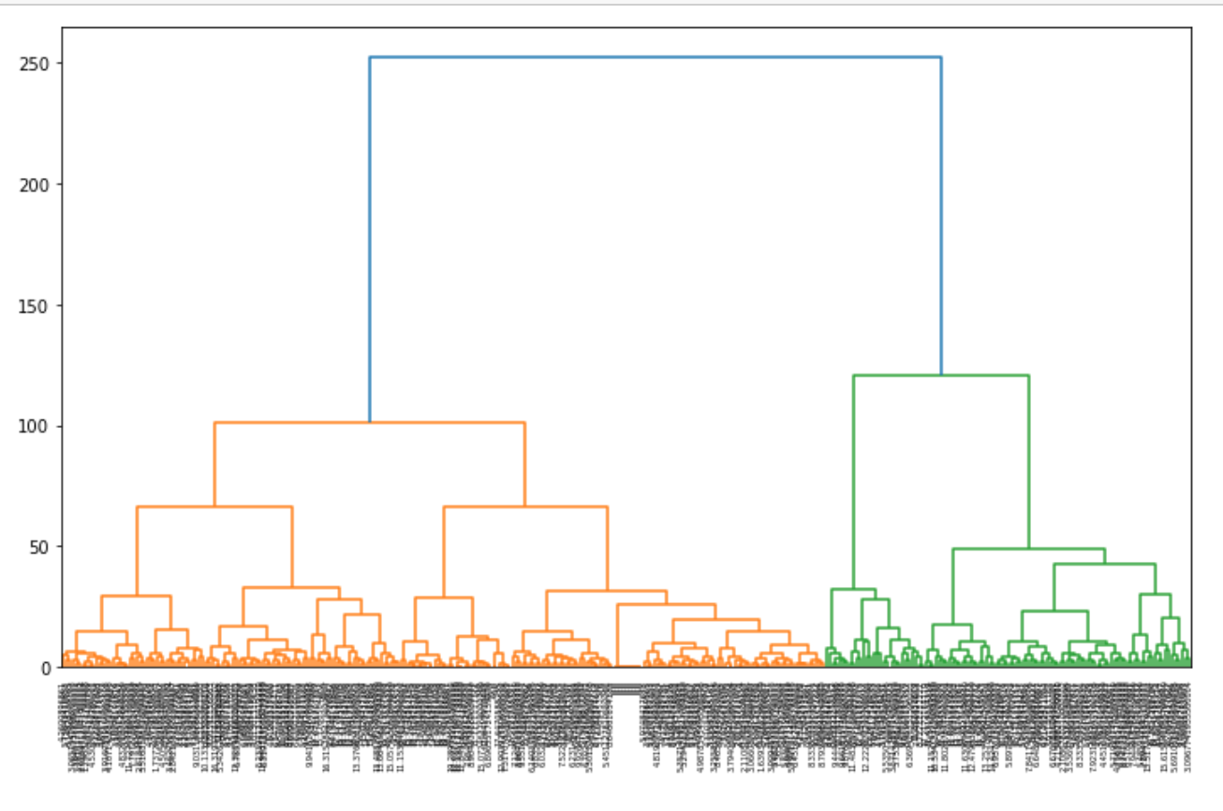
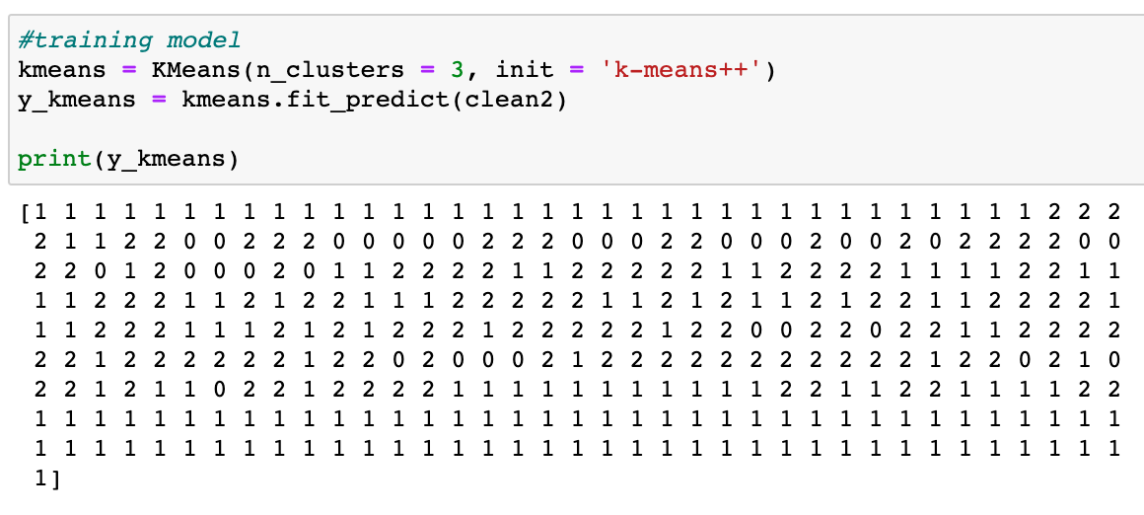
Unsupervised Machine Learning Model: K-Means
Training the K-Means model based on the optimal number of clusters
Dendrogram

Slide 10
Final Project Key Learnings
Understand your data really well before modeling it
Experiment with different pre-processing techniques and tuning the model, as they can significantly improve the accuracy of your models
Visualize your data to understand and model it better
Test your data for underfitting and overfitting to make sure your model’s predictions are accurate
Comment your code as you’re working on it - it’ll help understand what each line of code does in the future and it’ll also make it easy for others to interpret your code
Based on modeling this dataset, we can predict the future data(covid-19 test positivity rate) with 80% or more accuracy

